Slide 1

Statistical Fundamentals:
Using Microsoft Excel for Univariate and Bivariate Analysis
Alfred P. Rovai
Independent t-Test
PowerPoint Prepared by
Alfred P. Rovai
Microsoft® Excel® Screen Prints Courtesy of Microsoft Corporation.

Slide 2
Independent t-Test
The independent t-test, also known as student’s t-test and independent samples t-test, is a parametric procedure that assesses whether the means of two independent groups are statistically different from each other.
Groups can be formed by randomly assigning research participants to groups or conditions in an experiment or one can use naturally occurring independent groups, e.g., males and females.
Excel data entry for the independent t-test is accomplished by entering the IV (the grouping variable) and DV (the variable that is measured) as separate columns in an Excel spreadsheet. The IV must be entered as numerical data, e.g., treatment group = 1, control group = 2.

Slide 3
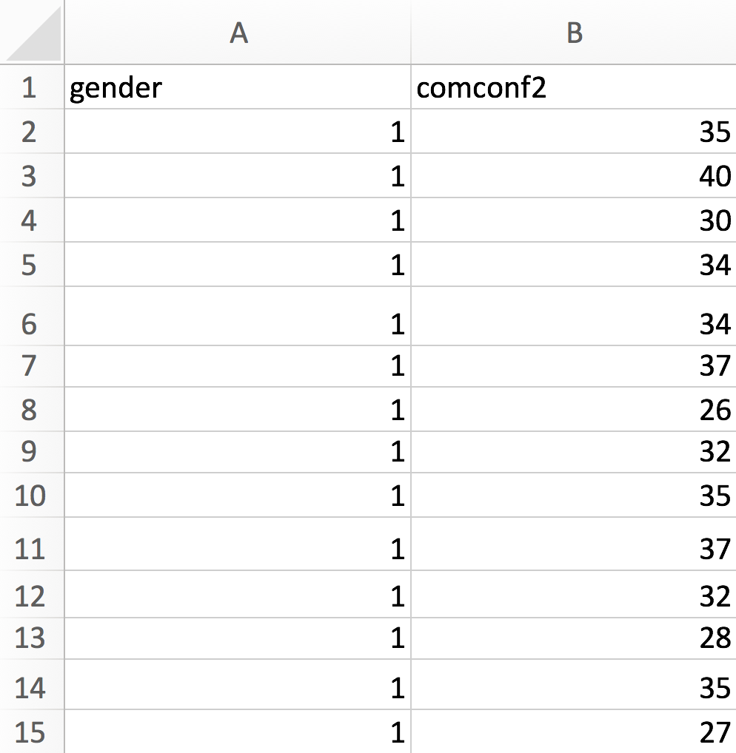
Independent t-Test Data Entry
The example to the left shows a partial worksheet with the IV (gender) in column A. The number 1 represents males and the number2 (not shown) represents females. Column B contains the DV orcomputer confidence posttest (comconf2).

Slide 4
Independent t-Test
One can compute the t-value using the following formula:
where the numerator is the difference in means of group 1 and group 2 and the denominator is the estimated standard error of the difference.

Slide 5
Independent t-Test
Cohen’s d measures effect size and is often used to report effect size following a significant t-test. The formula for Cohen’s d for the independent t-test is:
By convention, Cohen’s d values are interpreted as follows:
  Small effect size = .20
  Medium effect size = .50
  Large effect size = .80

Slide 6
Key Assumptions & Requirements
Random selection of samples to allow for generalization of results to a target population.
Variables. DV: one continuous variable, interval/ratio scale. IV: one categorical IV with two categories; e.g., group (treatment, control).
Independence of observations. Independence of observations means that observations (i.e., measurements) are not acted on by an outside influence common to two or more measurements, e.g., other research participants or previous measurements.
Normality. DV is normally distributed in each group. The independent t-test is robust to mild to moderate violations of normality assuming a sufficiently large sample size.
Absence of extreme outliers. Extreme outliers can distort the mean difference and the t-statistic. They tend to inflate the variance and depress the value and corresponding statistical significance of the t-statistic.
Homogeneity of variance.
Sample size. When sample sizes are large (i.e., when groups have >30 participants each) and are approximately equal in size, the robustness of this test to violation of the assumption of normality is improved.

Slide 7
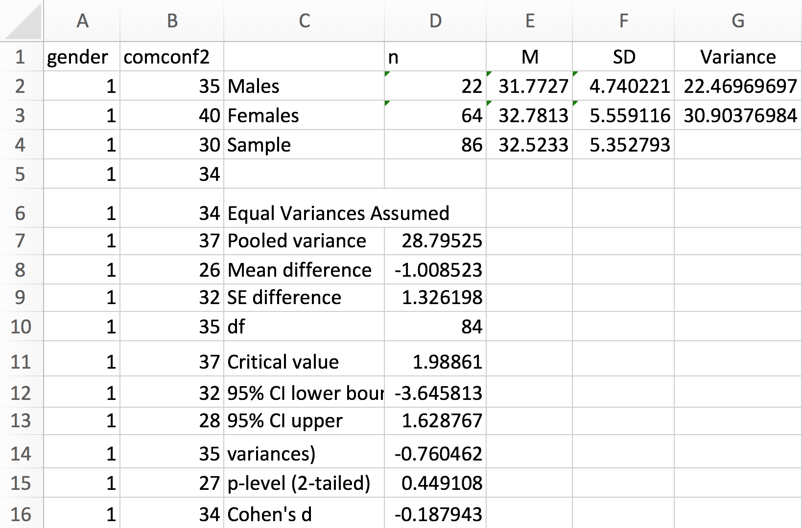
Open the dataset Computer Anxiety 3dEd.xlsx. Click on the Independent t-Test worksheet tab.
File available at http://www.watertreepress.com/stats
TASK
Respond to the following research question and null hypothesis:
Is there a difference in mean computer confidence posttest (comconf2) between male and female university students, μ₁ ≠ μ₂?
H₀: There is no difference in mean computer confidence posttest between male and female university students, μ₁ = μ₂.

Slide 8
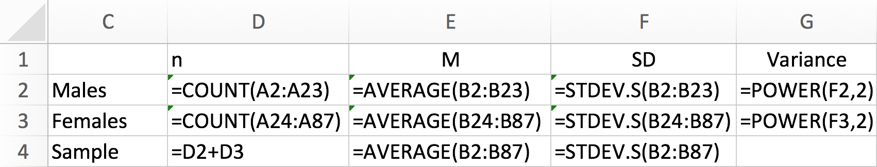
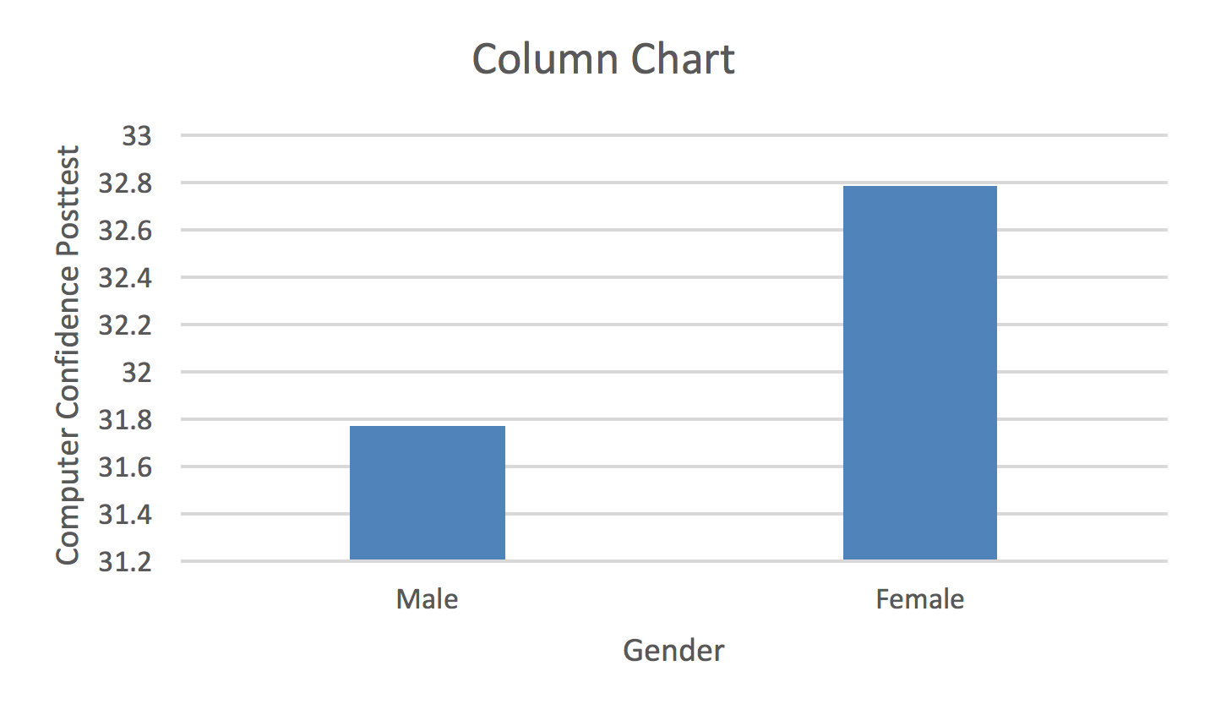
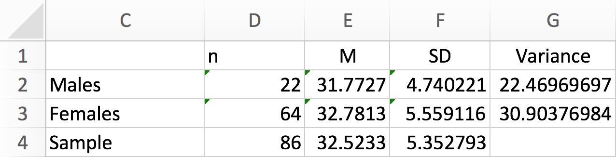
Descriptive Statistics
Enter the labels and formulas shown in cells C1:G4 in order to generate descriptive statistics. Results suggest that the groups have unequal variances. Further analysis using the F-test of equality of variance or Levene’s test is necessary to confirm this conclusion. Nonetheless, equal and unequal variance independent t-test models will be conducted. The conservative(recommended) approach is to use the unequal variance assumed results.

Slide 9
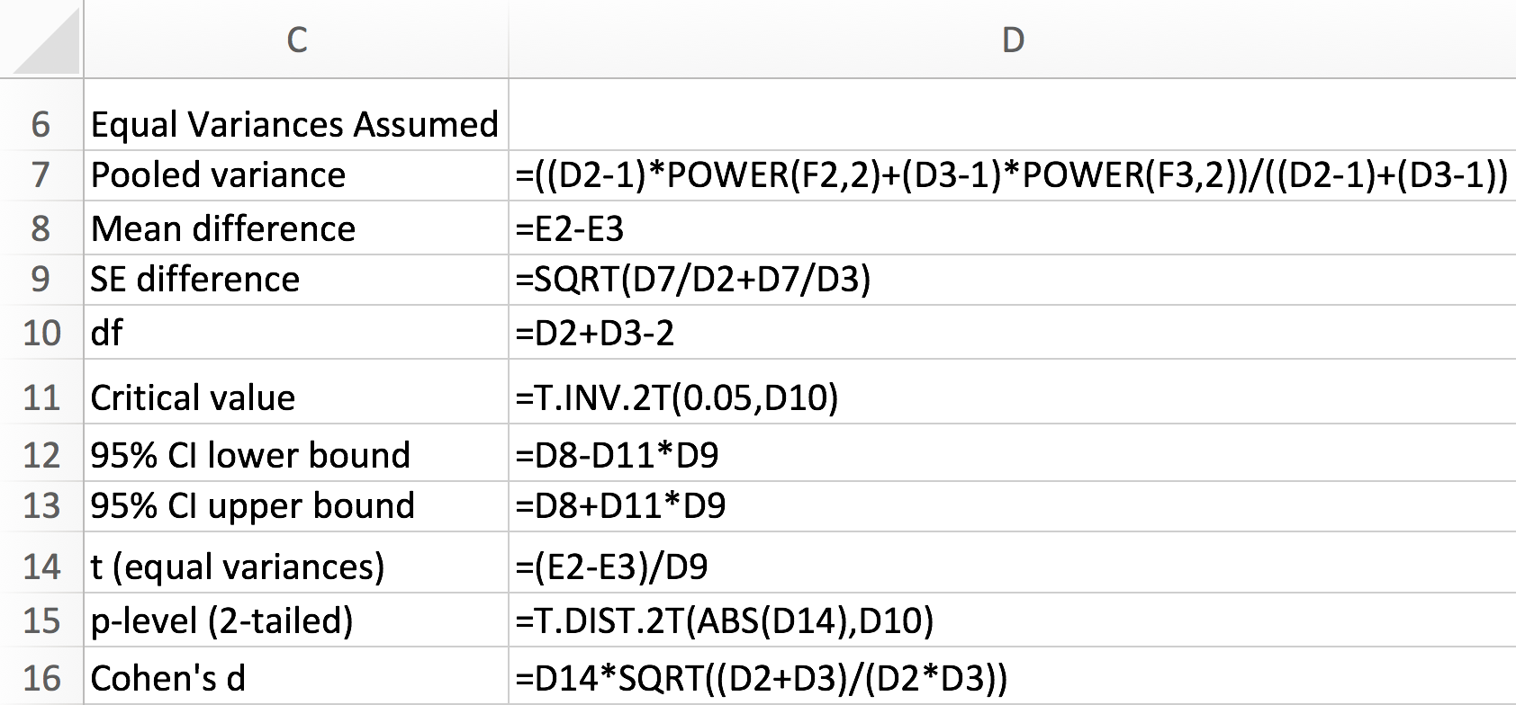
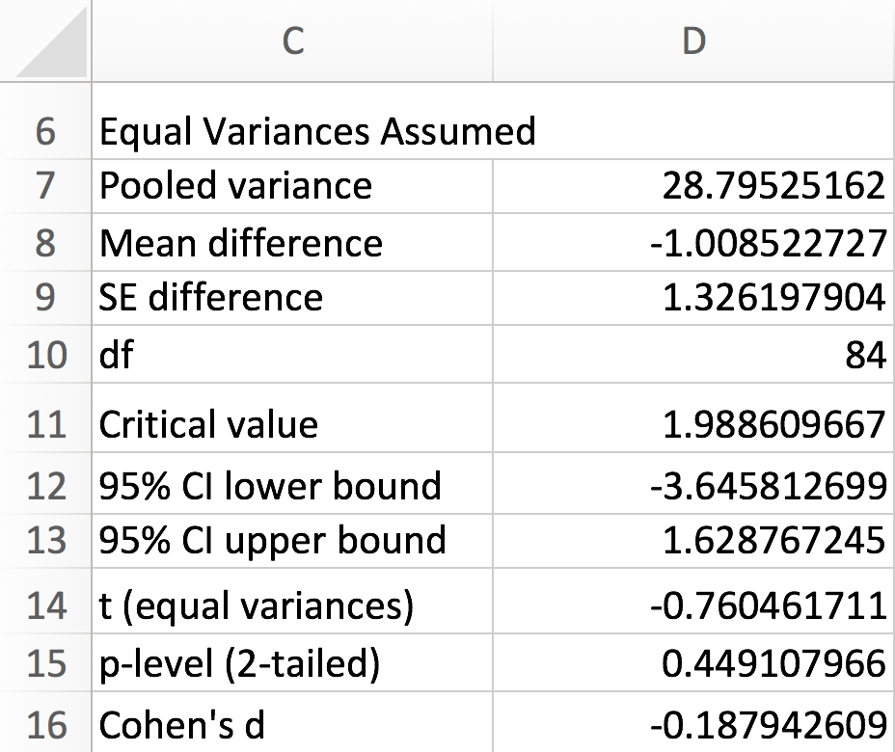
Equal Variances Assumed
Enter the formulas shown in cells D7:D16 in order to generate independent t-test results assuming equal variances.
Test results provide evidence that the difference in computer confidence posttest between the male group (M = 31.77, SD = 4.74) and the female group (M = 32.78, SD = 5.56) was not statistically significant, t(84) = .76, p = .45 (2-tailed), d = .19.

Slide 10
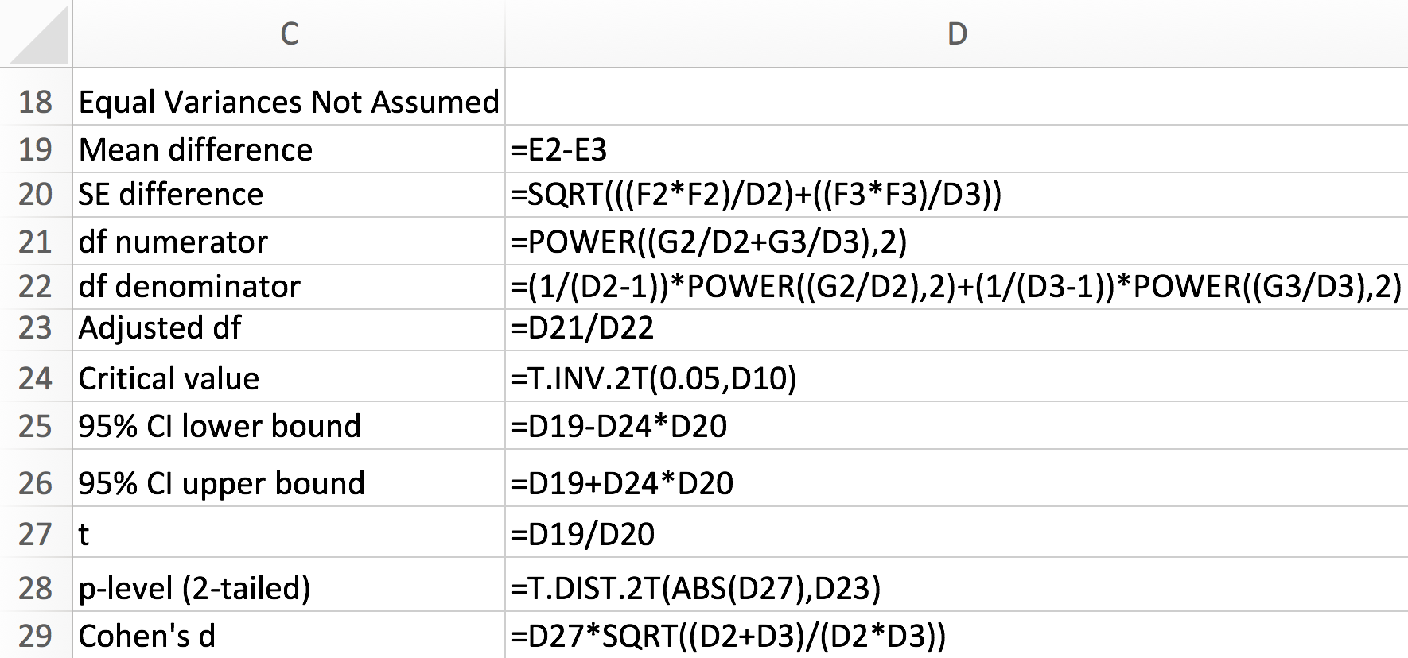
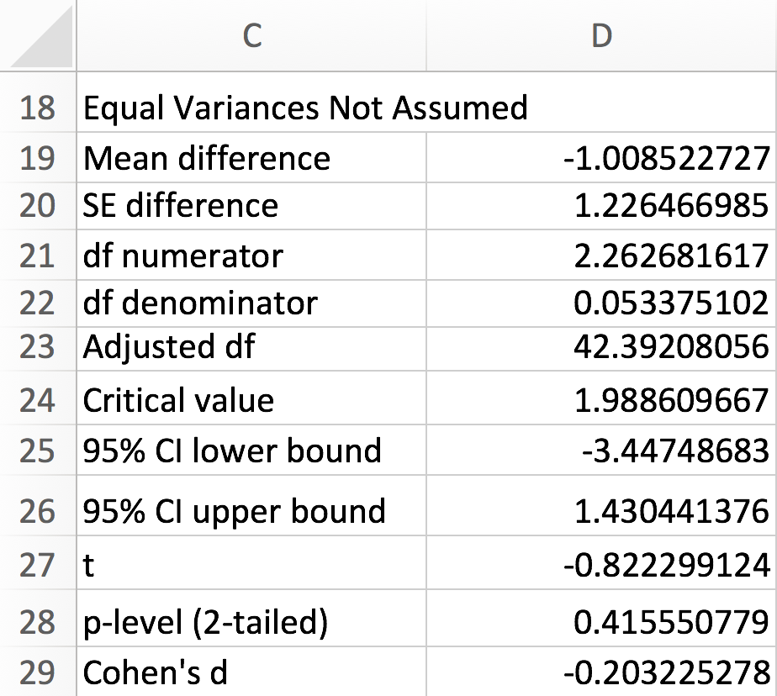
Equal Variances Not Assumed
Enter the formulas shown in cells D19:D29 in order to generate independent t-test results not assuming equal variances.
Test results assuming unequal variances provided evidence that the difference in computer confidence posttest between the male group (M = 31.77, SD = 4.74) and the female group (M = 32.78, SD = 5.56) was not statistically significant, t(42.39) = .82, p = .42 (2-tailed), d = .20.

Slide 11
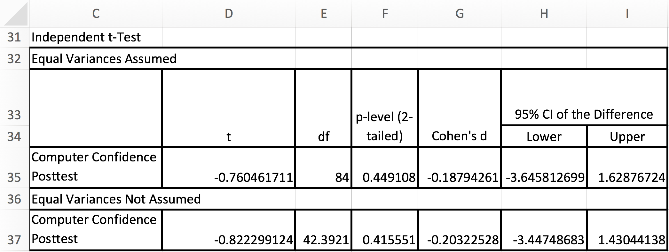
Test Results Summary
Test results provide evidence that there is insufficient evidence (p = 0.45) to reject the null hypothesis that there is no difference in mean computer confidence posttest between male and female university students.

Slide 12
Reporting Independent t-Test Results
As a minimum, the following information should be reported in the results section of any report: null hypothesis that is being evaluated, descriptive statistics (e.g., M, SD, N, n), statistical test used (i.e., independent t-test), results of evaluation of test assumptions, as appropriate, and test results. For example, one might report test results as follows. The formatting of the statistics in this example follows the guidelines provided in the Publication Manual of the American Psychological Association (APA).
Results
An Independent t-test (unequal variances assumed) was conducted to evaluate the null hypothesis that there is no difference in computer confidence posttest between male and female university students (N = 86). Test results provided evidence that the difference in computer confidence posttest between the male group (M = 31.77, SD = 4.74) and the female group (M = 32.78, SD = 5.56) was not statistically significant, t(42.39) = .82, p = .42 (2-tailed), d = 0.20. Therefore, there was insufficient evidence to reject the null hypothesis.

Slide 13
Independent t-Test
End of Presentation

